Slide 1
Advanced Data Analysis with TIBCO Spotfire
Pablo Maldonado, Ph.D.

Slide 2
About your trainer
Pablo Maldonado, Ph.D.
Data Science/Analytics Trainer & Consultant.
Project experience in
Telco (CRM / marketing).
Ecommerce and digital marketing.
Analysis of sensor data.

Slide 3
About you
Who are you and what do you do? ☺
What is your previous experience with Spotfire?
What do you expect to get from this course?
What is your main challenge with Spotfire?

Slide 4
Course Outline
Day 1 | Day 2
Overview Loading and managing datasets Working with visualizations Data manipulation in visualizations | Customizing the dashboard Interactive features Tools R and Python scripting

Slide 5
Timeline
Hands-On: You can follow along, all materials will be available after the course.
https://github.com/jpmaldonado/np-spotfire-advanced
2x90 min Morning session
1 hr Lunch break
2x90 min Afternoon session
Short breaks within morning and afternoon sessions.

Slide 6
Getting started
Create trial account for TIBCO Spotfire Cloud
https://www.tibco.com/spotfire-trial
Download & install TIBCO Spotfire Desktop
https://edelivery.tibco.com/storefront/eval/tibco-spotfire-desktop/prod10954.html

Slide 7
Spotfire at a glance

Slide 8
What is Tibco Spotfire?
Data visualization & analytics software for enterprise-grade solutions.
Main competitors: Qlikview, Tableau, PowerBI.
Advantages:
More connectors.
Good integration with C#/IronPython/R 🡺 More flexibility.
Quick prototyping.

Slide 9
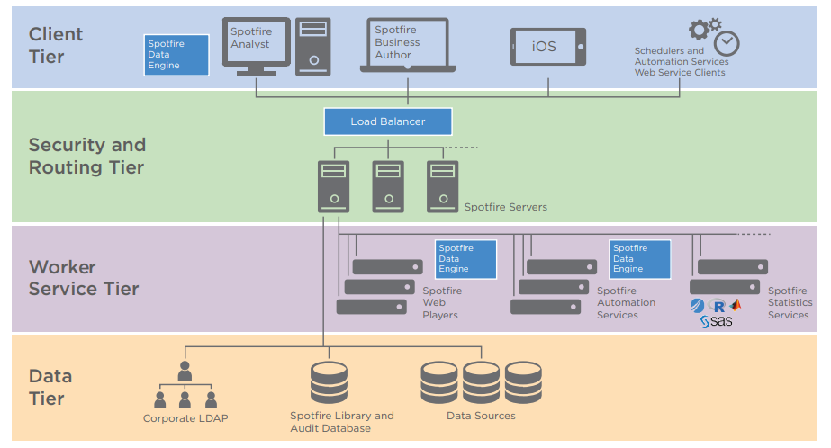
Spotfire Architecture

Slide 10
Spotfire Client Applications
Desktop
Spotfire Analyst: on-premises Spotfire server
Spotfire Cloud Analyst: connects to cloud-based instance.
macOS: wrapper around Spotfire web clients
Web
Spotfire Consumer: read-only web client.
Spotfire Business Author: Some authoring capabilities, like loading data and editing visualizations.
Mobile
Consumer-type client for iOS and Android.

Slide 11
Exercise
Use the “injuries.csv” dataset in the “neiss” folder.
Import the data into Spotfire.
Create 4 different visualizations to investigate the most common causes of accidents, age group, gender and location. You can use details visualization for incorporating different markings.
➔ Create filters in different ways:
Create filtering scheme.
Add filter from text area.
Create a filter through expressions.
Add some interactive action through text area.

Slide 12
Exercise
➔ flight_delays file in Github repo.
Create a calculated column for TotalDelay = ArrDelay + DepartureDelay.
Calculate total delay per carrier, as well as per carrier and origin.
One visualization using OVER.
One visualization using OVER and Intersect.
One visualization using rules (show/hide).

Slide 13
Spotfire Overview
The user interface
Interactive Dashboards
Sharing and Collaborating tools

Slide 14
Loading and managing datasets
Information Links and Data Connectors
Creating relations and column matches

Slide 15
Working with visualizations
Tabular visualizations (table, cross-table, summary table and graphical table)
Classical charts: bar chart, line chart and combination chart
Pie chart, scatter plot and map chart
Tree maps and heatmaps
KPI chart

Slide 16
Data Manipulation in visualizations
Custom expressions: limit data and value axis
Binning
Limit data using markings
Filtering schemes
“Filtering” through document properties and custom expressions
Hierarchies: time series and custom
Data on demand and details on demand
Subsets
Rules
Lists

Slide 17
Customizing the dashboard
Add a Cover page
Pages layout
Visualization layout
Visual themes
Cobranding

Slide 18
Interactive features in the text area
Filters on the text area
Dynamic items: KPIs and labels
Add images
Document properties and property controls
Filtering through custom expressions and document properties
Custom HTML objects
Action controls

Slide 19
Tools
Search bar
Data relationships
Analytics tools
Library administration

Slide 20
R and Python Scripting
Custom analytical functions (R/Python)
Interactive features (IronPython)
Custom data manipulation (R/Python)

